Slide 1
Trans-Atlantic Slave Trade
African-American History (06/16/20)
Haricesh Ratnaharan and Rohan Mutalik
Midterm Project Presentation
DSBA 5122

Slide 2
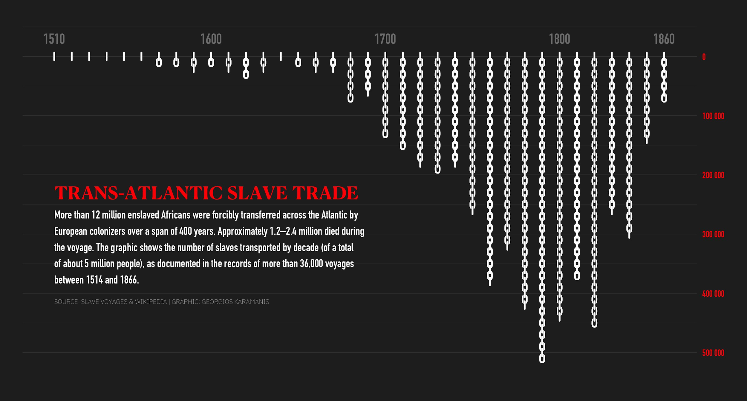
#TidyTuesday Dataset: Trans-Atlantic Slave Trade
Georgios Karamanis @geokaramanis https://twitter.com/geokaramanis/status/1273663628315680772
Notes:
We chose to do a tidy tuesday presentation on the trans-Atlantic slave trade because history books have taught us one thing but the numbers could tell us other pieces of information that may be hidden. This graphic displays the number of slaves per time period in a histogram-like format..(then go into what x-axis, y-axis, design elements)

Slide 3
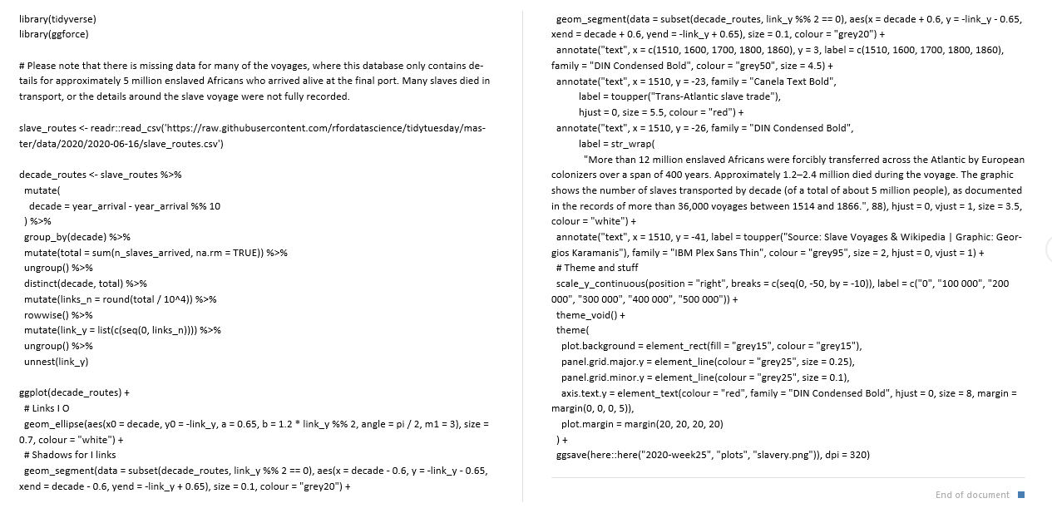
slavery.R file
https://github.com/gkaramanis/tidytuesday/tree/master/2020-week25

Slide 4
Dataset Overview
“Slave Routes dataset shows number of slaves transported by decade (36k total records)
Columns include:
Voyage ID (num), Ship Name (chr) , Port of Origin (chr), Place of Purchase (chr), Port of Arrival (chr), Year of Arrival (num), Number of Slaves that Arrived (num), Captain’s Name (chr)

Slide 5
Critique
Good Design Aspects
Clear data distribution
Clean background
Data is scaled properly
Heading description establishes context
Chain graphic represents trans-Atlantic slaves
Color scheme is appropriate; red, white colors are good contrasting colors
y-axis values increasing downwards - Can symbolize chains hanging down

Slide 6
Critique cont’d
Possible Improvements
The visualization did not scale well
Add ports of origin and of destination and use world map as backdrop
Hover over a chain to find number of slaves transported along a route
Show plots faceted by region
Cumulative summaries can help understand scale of trans-Atlantic slavery
Notes:
The visualization did not scale well - When you change the viewing window, the text overlaps the actual plot. (this does not work well with flexdashboard layouts)

Slide 7
Critique cont’d
Questions about the Code
It is not clear what ‘link_y’ variable in decade_routes represents. What does that represent?
Why use shadows for the I links, if they are not even visible?
Good Visualization Principles
Including annotations gave more information about the plot, as cited in Healy Section 5.5

Slide 8
Design
Tasks
Click on chain link on world map to show chain link zoomed in, highlighted in red in plot below
The tabs on the left describe the information on that chain link; can filter by decade
Click on decade to zoom in and see number of slaves per individual year
Double click on chain link to see number of slaves faceted by region
Hover over chain link to see cumulative summary up to that chain link
User Instructions
Legend guide that explains the tasks, or shows tooltip of tasks when hovered over.

Slide 9
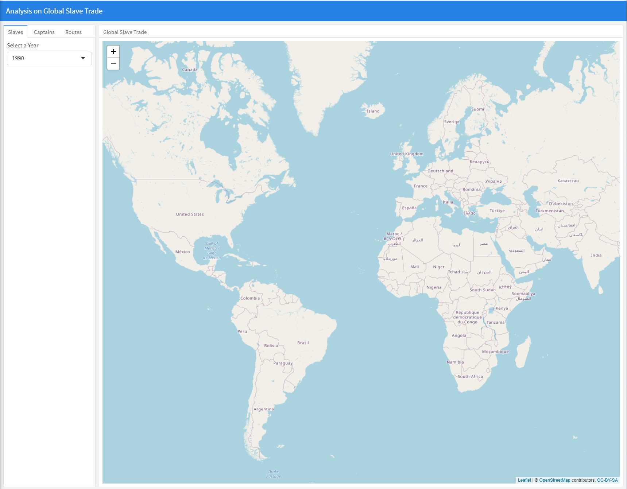
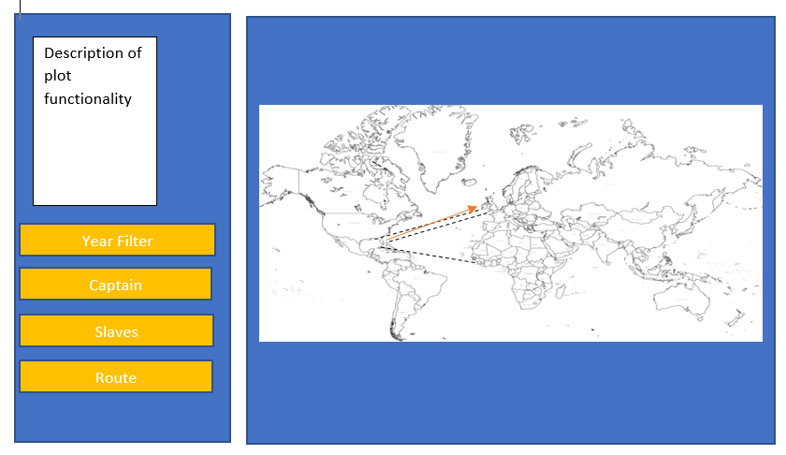
Tabs in sidebar will contain different pieces of information regarding the slave trade
Notes:
We used flexdashboard for the layout, and we want to use shiny for the interactivity, like clicking, zooming, and hovering.

Slide 10
Thank you!
Any questions?

